Slide 1
Eagle Sat 2:
Development and Implementation of a Self-Contained Harness for In-House Integration, Verification and Validation Testing of CubeSat Electric Power Systems
Lorenzo Kearns and Andre Simmons, Electrical Power Subsystems (EPS) and Fabrications Team
Arizona Space Grant Consortium Symposium
April 17th, 2021

Slide 2
Overview
Requirements for Battery Integration
Prototype Boards
Simulated Solar Array
Inter Integrated Circuit Communication(I2C)
Next Steps

Slide 3
Requirements for Battery Integration
Charging of battery
Trickle charging via 5v USB rail
Charging through solar panels
Simulated solar array
Verification of charge
Measuring voltage with voltmeter
Checking voltage from I2C
Coulomb counting with I2C
Degree of current protection
Current protections of at least two degrees
Additional current protection will be ensured on the delivered battery charger

Slide 4
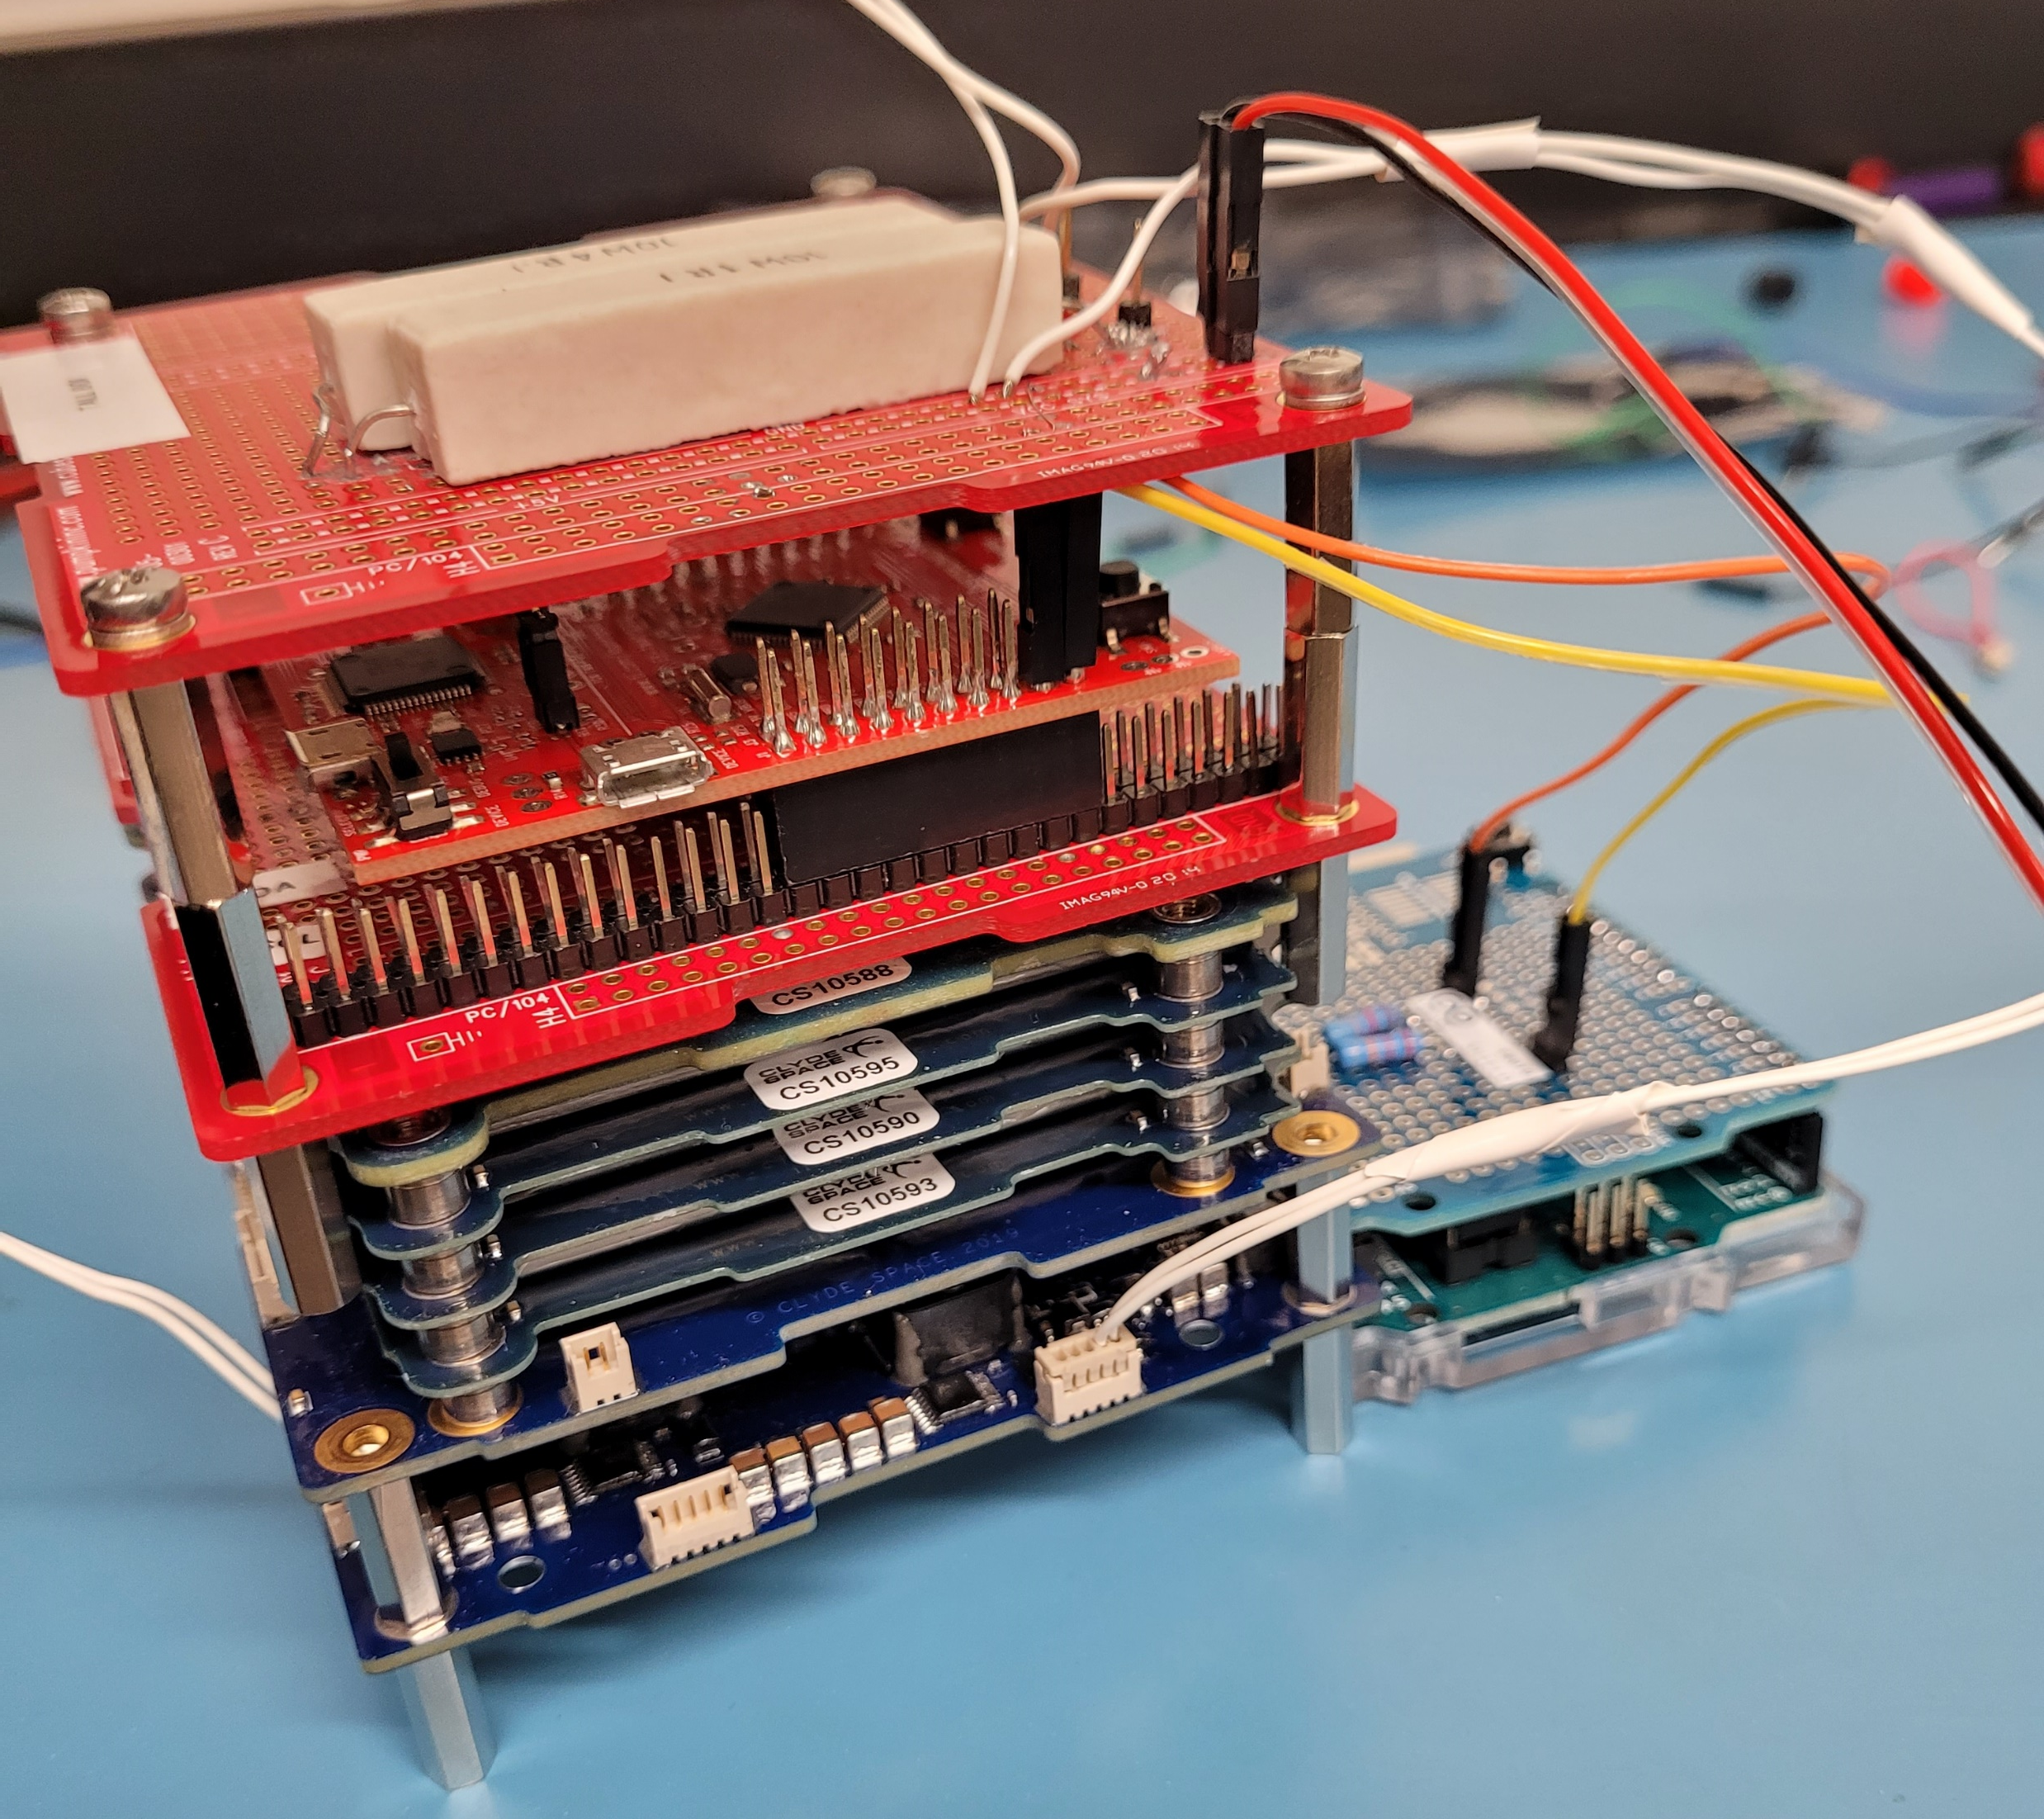
Prototype Boards
Prototype 1
No communications
Power supply conducting trickle charge through 5v USB rail
Prototype 2
No communications
Power supply through breadboard and inline resistor
Prototype 3
I2C communications through TM4C123GXL
Power supply through a circuit on pumpkin development kit
I2C hardware through separate Arduino powered circuit

Slide 5
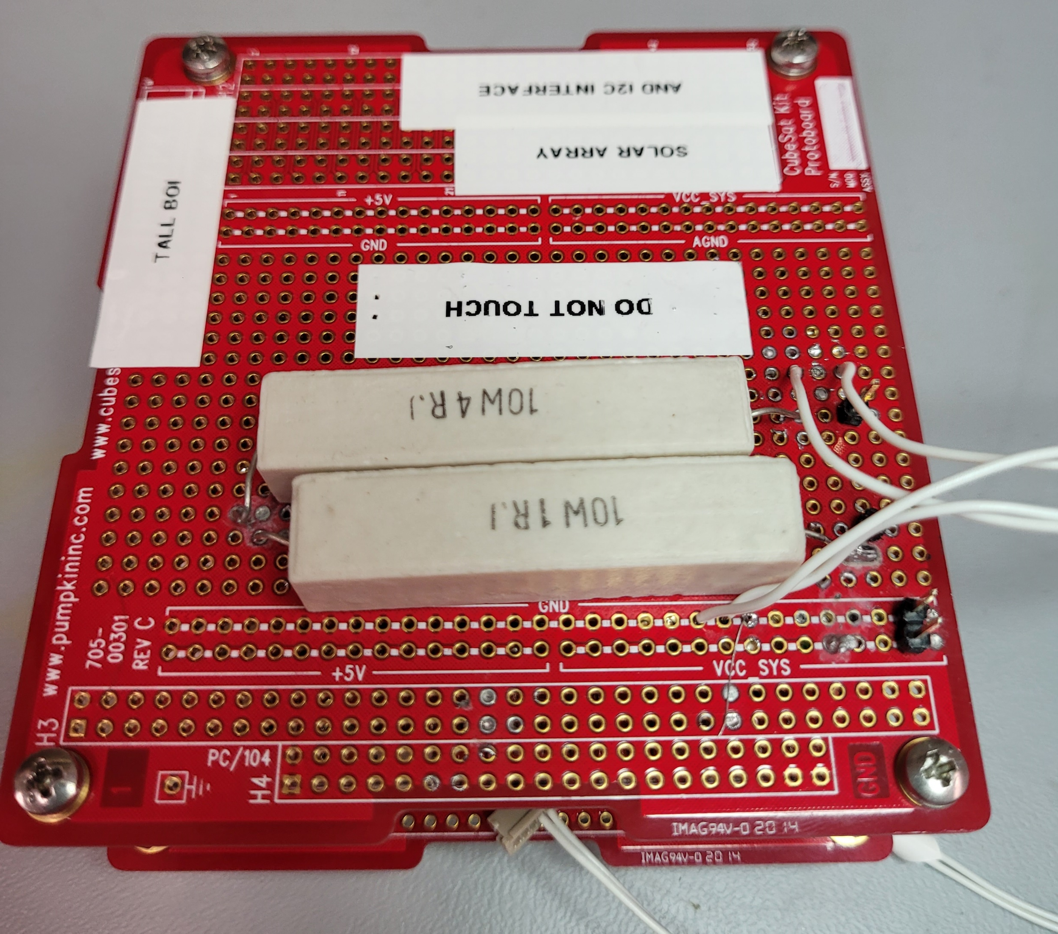
Simulated Solar Array
Provide power to battery via solar panel connections
Prototype 3
In-line resistor connected with power supply
Male Solar panel header pins
Final version
Current mirrors for additional connections
External power via USB
Current safety laches for additional degree of safety

Slide 6
Inter Integrated Circuit Communication(I2C)
Hardware
TM4C123GXL
Arduino I2C pull up circuit
PC104 for integration with EPS board
Software
C program with Interrupt service routine
UART menu for command control
Interrupt timer for command polling

Slide 7
Next Steps
Develop single printed circuit board (PCB)
Develop black box for battery charger
Complete battery certifications

Slide 8
Acknowledgements
Embry-Riddle College of Engineering
NASA Space Grant
Dr. Ahmed Sulyman – Faculty Supervisor
Dr. Daniel White
Dr. Anne Boetcher

Slide 9
Thank You
Lorenzo Kearns
EagleSat 2 Electrical Power Systems Lead
Kearnsl@my.erau.edu
Andre Simmons
EagleSat 2 Fabrications Lead
Simmona8@my.erau.edu

